Slide 1
UNV Heat-Tracker series
Integrated wrist temperature measurement system
CW180 Introduction

Slide 2
Integrated wrist temperature measurement system
Appearance
Product Overview
CW180 is a Integrated wrist temperature measurement system , It consists of temperature measurement + Image Acquisition system, date storage and business showing system, HD display system.
This system has such advantages as high accuracy of measuring temperature, complete business showing, high equipment integration. It can be flexible deployed, and be widely used in school, hotel, enterprise, government building, supermarket, business premises, etc.

Slide 3
Integrated wrist temperature measurement system
Module Presentation
①
Face Capture Module：
Detect human face , snapshot face Images, collect and overlay temperature infomation.
②
Display Module：
Display the temperature measurement interface of NVR.
③
Temperature Measurement Module:
Detect wrist temperature information.
④
Brackets Module：
Install IPC, screen, temperature measurement module and associated equipment. It can be adjusted up and down and move freely.
⑤
Recording Module：
Receive face images and temperature information from the front end, show locally, store data and export reports.

Slide 4
Integrated wrist temperature measurement system
Product Features
Local Business:
Live preview
Display the temperature information and face Image
Support real-time statistics of total number of temperature measurement, normal and abnormal number of people
Guiding picture and video（Self-replacement）
Export the report
Local Business
Mobile APP Business（selectable）
Remote Business：
Real-time preview
The picture of abnormal problems and the alarm reminder

Slide 5
Integrated wrist temperature measurement system
IPC Features
1
2
3
Snapshot of human face with mask
Collect and overlay temperature information
Voice broadcast

Slide 6
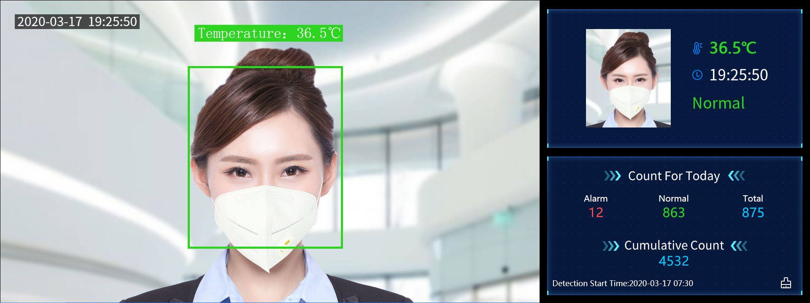
Integrated wrist temperature measurement system
NVR Features
Temperature measurement part
①Live interface：Show live screen
②Temperature display interface：show the information of snapped face, temperature, temperature status
③Detection number interface：display the number of historical detection , total today, normal and alarm
Advertising part
①Display advertising：
Freely overlay advertising image information
Note: This interface is a temporary interface, which will be dynamically adjusted when publishing
②Video advertising：
Freely overlay promotional ads

Slide 7
Integrated wrist temperature measurement system
NVR Report export
Table
Number of alarms | 0
Normal number | 2
Total People | 2
Camera | Name | Time | Temperature | Result | Path
D1 | Temp Detection Camera 01 | XXX | 36.9 | Normal | ./Image\D1_Temp Detection Camera 01_20200330093827_36.90.jpg
D1 | Temp Detection Camera 01 | XXX | 36.6 | Normal | ./Image\D1_Temp Detection Camera 01_20200330093833_36.60.jpg
Hyperlinks
One-to-one correspondence between report and picture
Face Picture Part

Slide 8
Integrated wrist temperature measurement system
Monitor Features
Industrial-grade panels, work for 7*24 hours
LED backlight technology with full HD 1920×1080
User-friendly operation menu, which is simple to operate
High fidelity digital processing, brilliant and vivid video
Lower power consumption and long life cycle

Slide 9
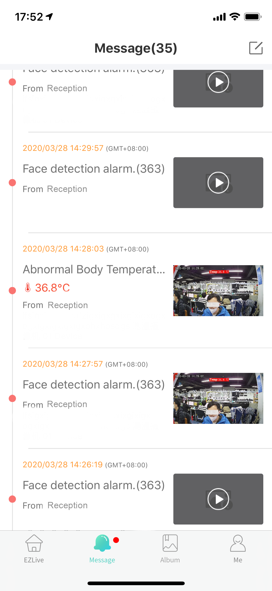
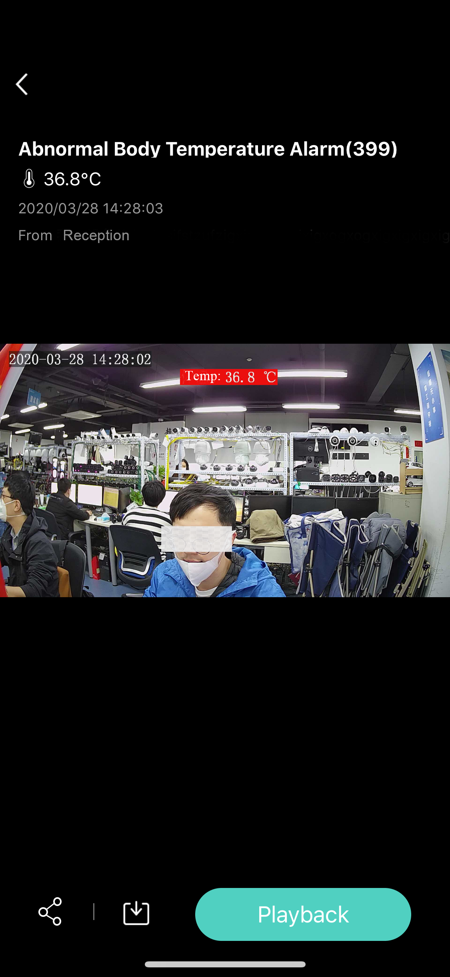
Integrated wrist temperature measurement system
APP Features
EZlive
Receiving temperature alarm information and pictures
View pictures
Alarm message reception
Record View

Slide 10
Integrated wrist temperature measurement system
Temperature measurement process
1. Stand inside the specified area
2. Put wrist close to the device
3. Tips for temperature test result
4.Mobile APP
Receive the abnormal temperature information
OR
DI DI DI !
Abnormal body temperature
Normal body temperature
4.Local Business
Local report export
( For recording )

Slide 11
Integrated wrist temperature measurement system
Temperature measurement principle
Temperature sensor receives wrist temperature information
Temperature rise at the temperature detection termina
Be difference from non-temperature measuring end
An electromotive force occurs in the electrical circuit
Calculate the temperature value based on the electromotive force
①
⑤

Slide 12
Integrated wrist temperature measurement system
Application scenario
Enterprise
Supermarket
Hotel
Government
School

Slide 13
Better Security, Better World

