Slide 1
Fever Detection Face Recognition Terminal

Slide 2
Product overview
Highlights:
Fever detection + mask-missing detection
Safety, non-contact temperature measurement
Temperature information binding with face pictures
High efficiency, 20-30 people/min.
Recommended
Key Features:
EP-S31-W-NB
0.1℃ accuracy, 0.3℃ deviation temp measurement
10,000 face capacity, 7-inch touch screen
Multiple authentication mode
Dual-lens anti-spoofing
OET-213H
OEP-BTS1-NB
*Built-in bracket support wall-mounted installation. Floor-stand installation requires additional EP-S31-W-NB bracket.

Slide 3
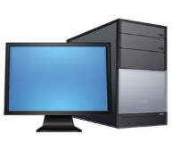
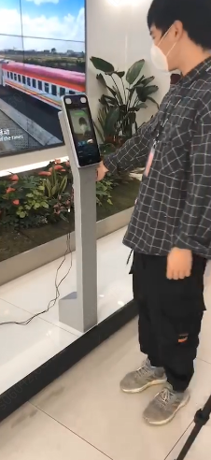
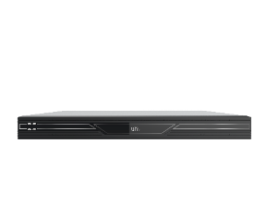
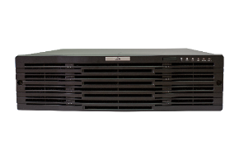
Solution overview
Terminal
EZStation (up to 8 terminals)
Face whitelist
or
LAN
VMS-B180-A (up to 25 terminals)
Face picture/ temperature/ time
or
Unicorn (up to 100 terminals)
*Only temp measurement mode do not request a face whitelist.

Slide 4
Typical application
School
Enterprise
Community
Factory
By automatic face recognition and temperature measurement process, this solution could be applied in various scenarios, such as school, enterprise, community, factory, helping you to recover from the epidemic.
This product is able to measure people’s body temp quickly. If someone temp is higher than threshold, a further, exact measurement is required. For example, a mercurial thermometer.

Slide 5
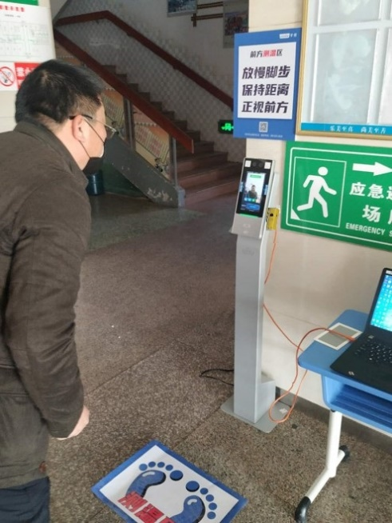
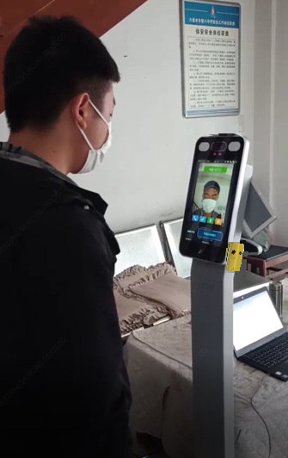
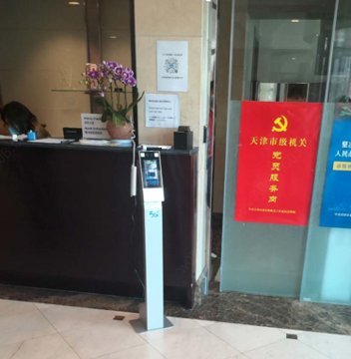
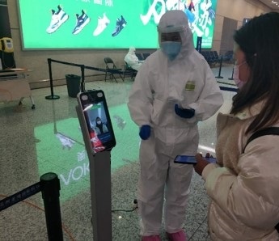
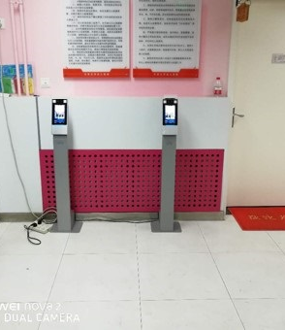
Typical application
Enterprise
School
Building
Transportation hub
Kindergarten
These are some good application. Devices are deployed indoor, and temp measurement check-point is manned all the time. So if there is a person with abnormal temperature, he or she would be further inspected.

