Slide 1
UNV Heat-Tracker series
Body Temperature Measurement Solution & Products

Slide 2
03
Human Body Temperature Measurement Gate

Slide 3
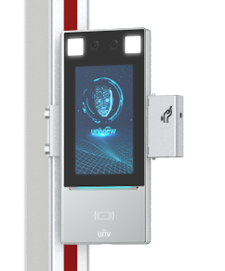
Human Body Temperature Measurement Gate
For OPD-533TM
Appearance
Control panel
Control unit
Temperature Measurement Module
LCD screen
Pass count
Alarm count
Metal Detector
Temperature Measurement Terminal
Infrared Sensor

Slide 4
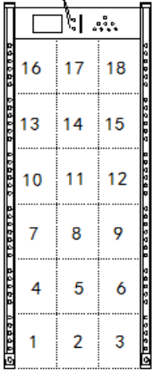
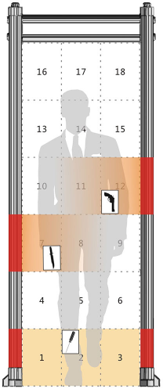
Human Body Temperature Measurement Gate
For OPD-533TM
Metal Detection Function Show
Both the left and right panels have 6 sets of pinpoint LEDs for 18 detection zones, as shown in the figure.
A detection zone LED is either on or off. When a metallic object is detected, a detection zone LED turns on and the alarm sounds.
18 Metal Detection Zones
Metal Detection Alarm Light

Slide 5
Human Body Temperature Measurement Gate
For OPD-533TM
Product Highlights
Metal Detection & Temperature Measurement & Face Recognition
Metal detection for 18 zones.
256 level of metal detection sensitivity.
1 - 2.5 cm, Non-contact body temperature measurement.
Temperature measurement and people counting statistics.
The temperature linkage with face capture.
Face recognition rate: >99%

Slide 6
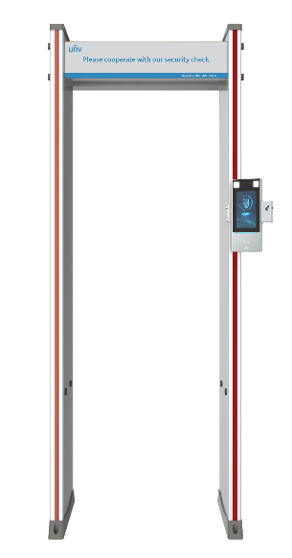
Human Body Temperature Measurement Gate
For OPD-533TM
Specifications
Wrist temperature measurement
Metal detection sensitivity: 0-255 levels for each detection zone.
Measurement Deviation 0.3℃
Measurement Accuracy 0.1℃
Measurement Range 30℃~45℃
Operating temperature 15℃ to 30℃
Face information binds with temperature record.

Slide 7
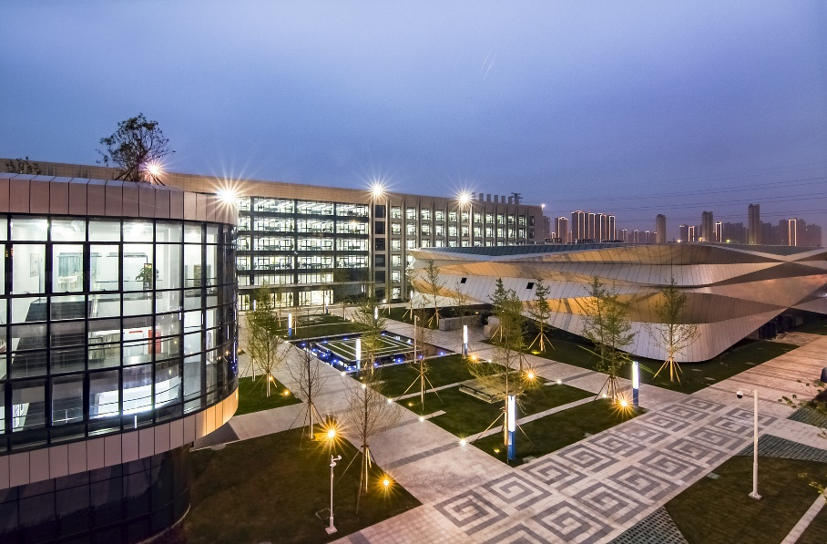
Scenario
Enterprise entrance:
office area, canteen, warehouse
Campus entrance:
teaching building, dormitory, library, canteen
Station entrance:
airport, metro line, seaport

