Slide 1
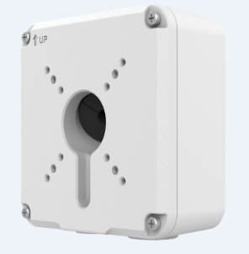
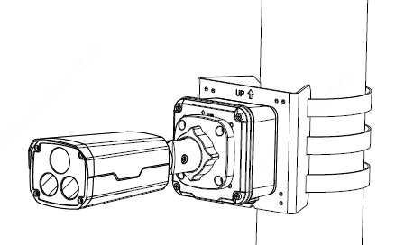
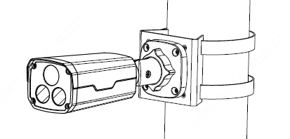
Bullet camera mount
Junction box
TR-JB07-D-IN
NPT ¾”Plastic
Waterproof joint
Optional
LPR
TR-A01-IN
Pole mount
Recommended side outlet for cable
Pole mount
TR-UP06-C-IN
TR-UP06-B-IN

